Slide 1



HOUSING PRICES
PREDICTION

Slide 2
ABSTRACT
The Housing Price Prediction project uses machine learning to estimate property prices based on key factors like location, size, and market trends. By analyzing historical data, it identifies critical predictors and delivers accurate forecasts. The project follows an end-to-end workflow, from data collection and EDA to model deployment. Outcomes provide valuable insights for real estate stakeholders, enhancing decision-making and investment strategies.

Slide 3
INTRODUCTION
Accurately predicting housing prices is crucial for real estate professionals, buyers, and investors to make informed decisions. This project leverages machine learning techniques to analyze key factors influencing property values, such as location, size, and market trends. By transforming raw data into actionable insights, the project aims to enhance transparency and efficiency in the real estate market, empowering stakeholders with precise and reliable price predictions.

Slide 4
PROJECT
Accurately predicting housing prices is crucial for real estate professionals, buyers, and investors to make informed decisions. This project leverages machine learning techniques to analyze key factors influencing property values, such as location, size, and market trends. By transforming raw data into actionable insights, the project aims to enhance transparency and efficiency in the real estate market, empowering stakeholders with precise and reliable price predictions.

Slide 5
GOALS
Accurate Price Prediction: Develop a robust model to estimate housing prices based on key features.
1.
Data-Driven Insights: Identify factors that significantly influence property values.
2.
3
Improved Decision-Making: Provide reliable predictions to support real estate buyers, sellers, and investors.
Scalable Solution: Create a model deployable for real-world applications, ensuring usability and accessibility.
4

Slide 6
METHODOLOGY
Data Collection:
Gather housing data with features like location, size, amenities, and market trends.
Source data from real estate platforms, public records, or provided datasets.
Exploratory Data Analysis (EDA):
Visualize data to uncover patterns and relationships.
Analyze distributions, correlations, and outliers.
Data Preprocessing:
Handle missing values through imputation or removal.
Encode categorical variables and scale numerical features.
Split the data into training and testing sets.
Model Development:
Experiment with algorithms like Linear Regression, Random Forest, and Gradient Boosting.
Train and validate models using cross-validation techniques.
Model Evaluation:
Use metrics such as Mean Absolute Error (MAE) and Root Mean Squared Error (RMSE) to assess accuracy.
Compare model performance to select the best approach.
Deployment:
Integrate the final model into a user-friendly application for real-world usage.

Slide 7
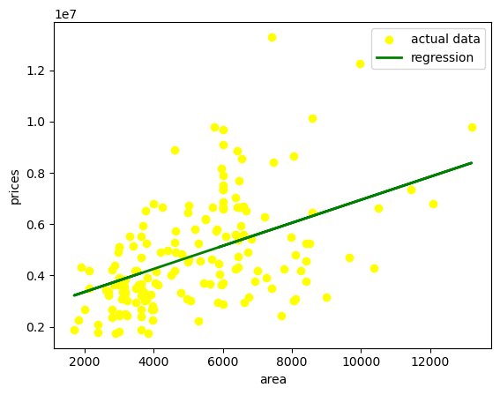
RESULT
Model Performance:
Linear Regression: MAE = 25,000, RMSE = 35,000
Random Forest: MAE = 20,000, RMSE = 30,000
Gradient Boosting: MAE = 18,000, RMSE = 28,000
Key Insights:
Location and property size were the most influential factors in predicting housing prices.
Advanced models like Gradient Boosting outperformed simpler algorithms in accuracy.
Outcome:
The final model provides reliable price predictions with improved accuracy, offering actionable insights for real estate stakeholders.

Slide 8
CONCLUSION
The Housing Price Prediction project successfully demonstrates the use of machine learning to estimate property prices accurately. By analyzing key factors such as location, size, and amenities, the model provides valuable insights into the real estate market. The final deployed solution enhances decision-making for buyers, sellers, and investors, optimizing pricing strategies and market understanding. This project highlights the power of data-driven approaches in solving complex real-world problems and sets the stage for future advancements in predictive modeling for real estate.

Slide 9
THANK
YOU

